Slide 1



FAIR WHEELS
Optimizing Used Car Pricing with Machine Learning

Slide 2

BUSINESS QUESTION?
How can we help buyers looking for used cars determine a fair market price and avoid overpaying by using a data-driven price prediction model?

Slide 3

Data Cleaning
Merged data across brands
The dataset contained two tax columns: 'tax' and 'tax(£)'. - removed duplicated column
Found 4,860 missing values in the 'tax' column.
Handled missing values - Grouped data by engineSize and fuelType, assuming cars with similar engine specs and fuel types pay similar tax.
Imputed missing values using the median tax within each group
Dropped the remaining 350 rows where imputation wasn't possible.
Standardised model entries by removing leading/trailing spaces (e.g., ' Fiesta' vs 'Fiesta')
Split the merged data back by brand to build and evaluate brand-specific price prediction models

Slide 4
Data Details
Data Source - Used Car Listings Dataset: Kaggle UK Used Car Listings Dataset
Dealer Inventory Records - Simulated multi-brand dealership data (Top 9 brands). 98,837 listings and 10 attributes
Contains:
Vehicle specifications: Year, Mileage, Engine Size, Fuel Type, Transmission
Market pricing info: Listed Price (target price), Model, Brand
Condition indicators: Age of Car, Mileage Tier, Engine Tier
Categorical features: Fuel Type (Diesel, Petrol, Hybrid, Electric), Transmission (Manual/Auto)
Brand-Specific Dealer Profiles: Simulated dealership characteristics for 9 brands (Audi, BMW, Ford, Hyundai, Mercedes, Skoda, Toyota, VW, Vauxhall)
Contains:
Basic details: Brand, Location, Inventory Composition
Operational data: Number of Models Available, Mileage Range, Price Range

Slide 5
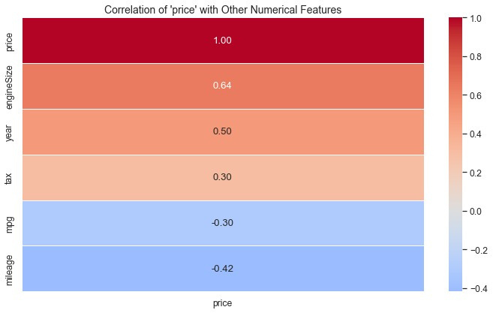
EDA – Used Car Pricing Patterns
Mileage & Mpg with Price Relationship: Higher mileage/mpg consistently lowers car prices across all brands, including luxury ones like BMW and Mercedes.
Fuel type impacts price: Diesel cars cost more than petrol, especially for VW and Skoda, while electric and hybrid prices vary with brand reputation.
Brand and Model Influence: Premium models like the BMW 3 Series, Audi A4, and Mercedes C-Class command higher prices, while brands like Hyundai and Ford have tighter, lower price ranges.

Slide 6

Prescriptive Model Overview
What:
Predicted optimal used car prices across 9 major brands and used those predictions to suggest brand-specific pricing strategies for dealerships.
Why:
To go beyond just predicting prices — by providing actionable recommendations that help customers compare prices offered by different dealers in their purchasing behavior.
How:
-Applied brand-wise modeling (Linear Regression, Decision Tree, and Random Forest) to estimate the fair market value of used cars based on age, mileage, fuel type, and more.
-Identified pricing thresholds and value drops to highlight when a car is over/under-valued relative to its peers.
-Used model results to simulate real-world pricing strategies such as:
Overpricing alerts for listings priced above model-predicted ranges (especially in high-mileage vehicles)
Value verification for listings priced within or below expected thresholds.

Slide 7
Modeling Approaches
We developed machine learning models that can predict the optimal used car price based on car features. Model selection was tailored to brand complexity, luxury brands with broader variance required more advanced models.
Models Used:
Feature Engineering:
Linear Regression: Baseline for price predictability and provides interpretability.
Decision Tree: Captures non-linear relationships and handles complex iteractions.
Random Forest: Used for accuracy in certain brands and improves performance in high-variance brands.
One-hot encoding used for categorical variables
Train-test split (70/30) for all brand models
Target variable: Car Price
Key features: Mileage, Year, Engine Size, Fuel Type, Transmission

Slide 8

Model Evaluation & Insights
The metrics used was Root Mean Squared Error (RMSE) in order to measure average prediction error.
Brand | Linear RMSE | Decision Tree RMSE | Random Forest RMSE | Best Model
VW | 2551.21 | 2133.65 | - | Decision Tree
Hyundai | 2041.13 | 2698.22 | - | Linear Regression
Skoda | 1828.48 | 1808.78 | - | Decision Tree
BMW | 4174.77 | - | 2358.94 | Random Forest
Toyoto | - | 1494.49 | 1155.10 | Random Forest
Ford | 1817.45 | 1609.35 | - | Decision Tree
Mercedes | 4061.10 | 4028.80 | - | Decision Tree
Audi | 3073.91 | 2933.60 | - | Decision Tree
Vauxhall | 2103.57 | 2056.22 | - | Decision Tree

Slide 9

KEY INSIGHTS
Mileage
Strong negative correlation with price across all brands.
Year
Newer cars are priced significantly higher.
Fuel Type
Diesel and hybrid models often show price premiums.
Transmission
Automatic cars tend to have higher average prices in premium brands.
Engine Size
Slight positive correlation, more noticeable in BMW and Mercedes

Slide 10
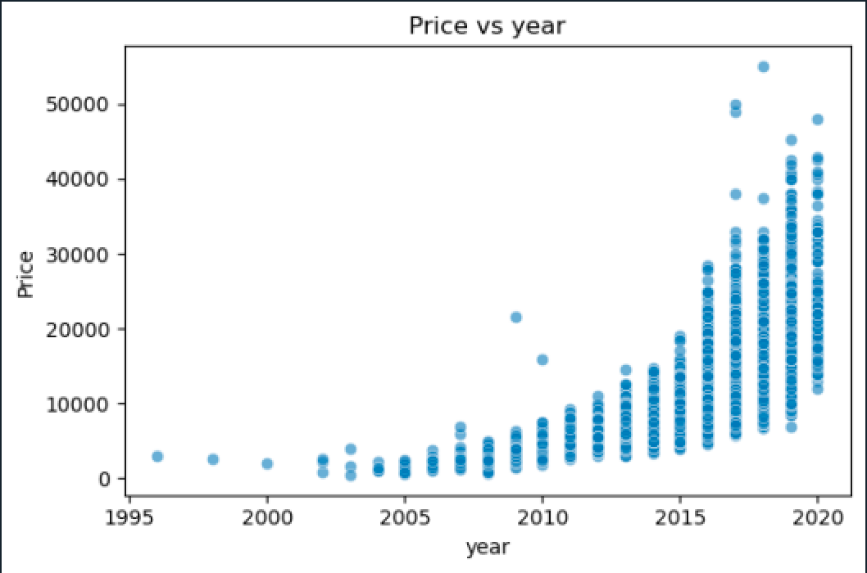
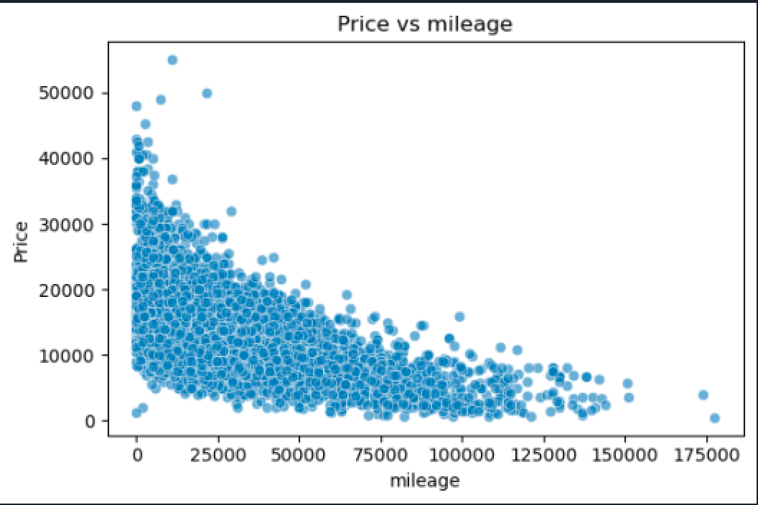
Key Insights
There's a strong positive trend — newer cars tend to be significantly more expensive.
Clear negative correlation — as mileage increases, price decreases.

Slide 11
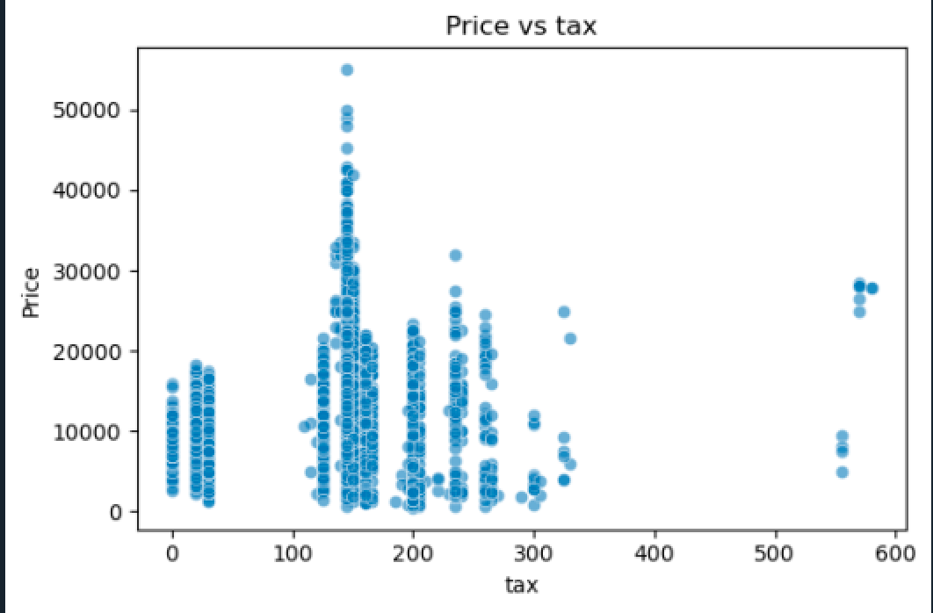
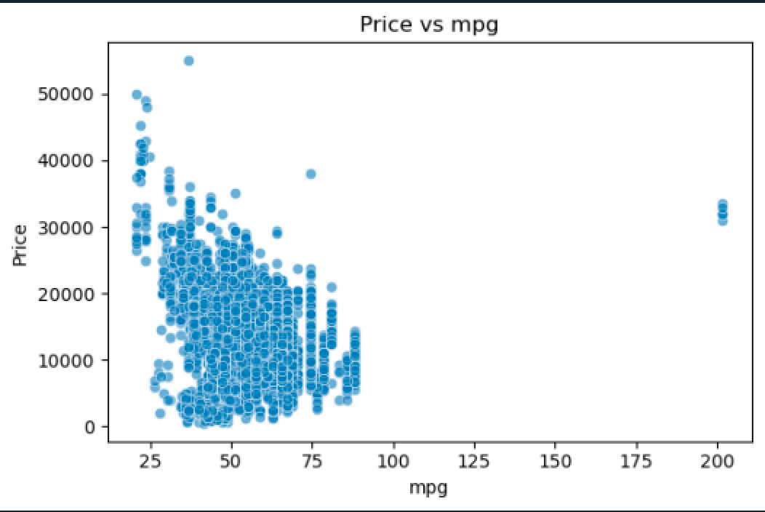
Key Insights
Tax appears to be categorical in bands (e.g., 0, 100, 150, 200), possibly linked to engine type or CO₂ emissions.
Overall negative trend — high mpg (fuel-efficient) cars are less expensive.

Slide 12
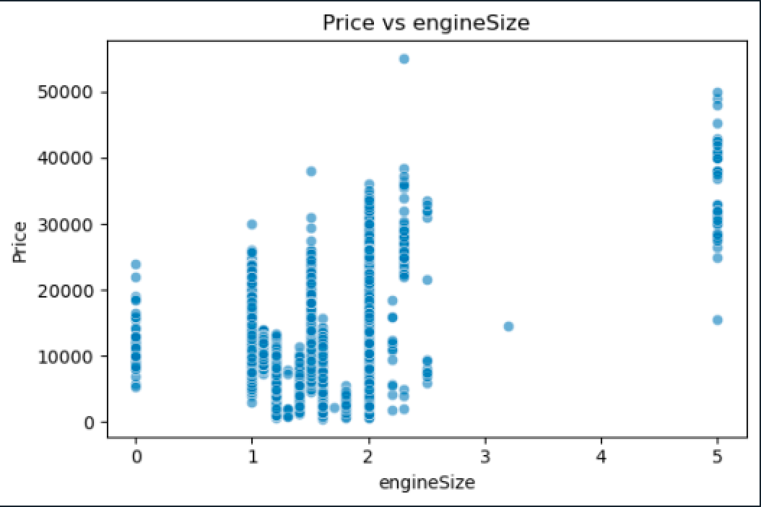
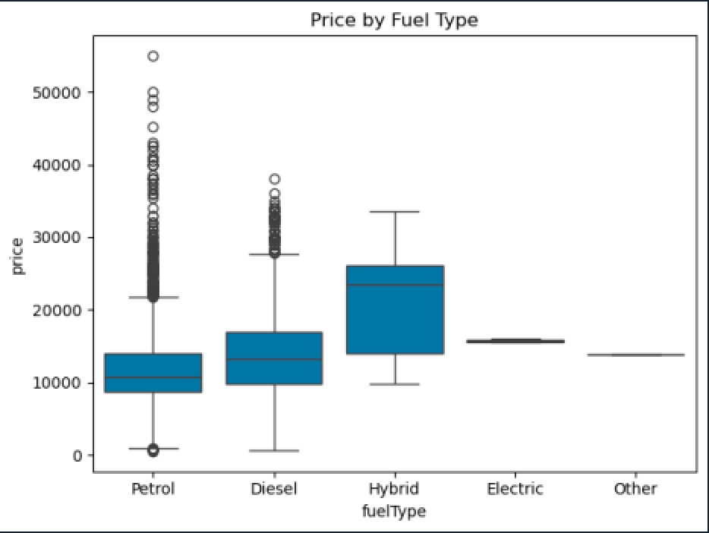
Key Insights
Price generally increases with engine size, with a clear cluster at engine sizes like 1.0, 2.0, and 5.0.
Hybrid cars show the highest median prices
Petrol and Diesel cars are most common
Electric and Other fuel types have stable pricing

Slide 13
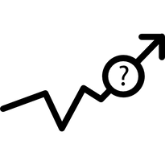




Challenges and Mitigations
Missing or Inconsistent Data
Presence of Outliers
Performed data cleaning using .dropna(), .strip(),
Detected extreme or unrealistic values (e.g., future years like 2060 or very high mileage) through boxplots and IQR
Model Overfitting
Used train-test split and compared multiple models
Increased model complexity
Built separate models for each brand to reduce complexity and improve accuracy.

